Slide 1
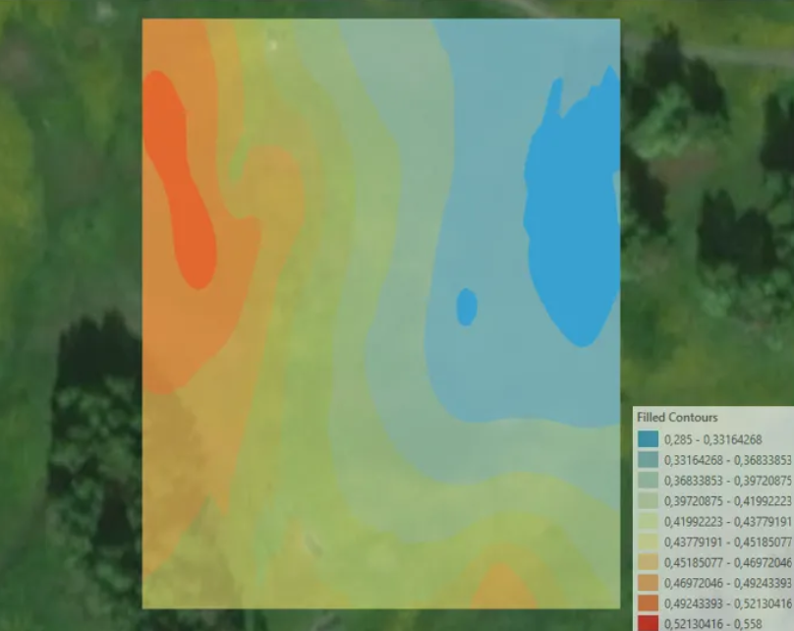
CMPE 255 | SHORT STORY ASSIGNMENT
How Machine Learning
Reads the Moisture
Beneath Our Feet
A survey of data-driven soil-moisture regression and classification
Navya Illa
Based on Tsimpidi et al., arXiv:2606.18316, 2026
Spatial variation over a grass-covered field in Luleå, Sweden
Notes:
Source: Tsimpidi et al. (2026), arXiv:2606.18316
https://arxiv.org/pdf/2606.18316

Slide 2
01 CONTEXT
Why soil moisture matters
The target changes across both space and time.
Hydrology
Agriculture
Scale
Soil moisture supports drought forecasting and flood forecasting. It describes how much water remains available in the ground.
Irrigation and crop-management decisions depend on the water available near roots, not just rainfall totals.
A few field sensors cannot cover every location, depth, season, and weather condition.
The observation gap
The modeling response
Ground sensors provide high-value local measurements, but they are sparse across fields, depths, and seasons.
Fuse limited ground truth with remote sensing, weather, soil, terrain, and recent history to estimate unobserved conditions.
Source: Tsimpidi et al. (2026), arXiv:2606.18316
02
Notes:
Source: Tsimpidi et al. (2026), arXiv:2606.18316
https://arxiv.org/pdf/2606.18316

Slide 3
02 PROBLEM FORMULATION
The modeling challenge
Four properties determine what the model can learn.
Spatiotemporal
Nonlinear
Multisource
Data-limited
Location, depth, season, and recent history all matter.
Climate, soil, vegetation, and terrain interact.
Sensors, satellites, reanalysis, and maps have different scales.
Ground observations are sparse and missing values are common.
A compact formulation
ŷ(s,t,d) = fθ(Xhistory, Xweather, Xsoil, Xterrain, Xremote)
The target location s, time t, and depth d determine what the prediction means.
Source: Tsimpidi et al. (2026), arXiv:2606.18316
03
Notes:
Source: Tsimpidi et al. (2026), arXiv:2606.18316
https://arxiv.org/pdf/2606.18316

Slide 4
03 DATA
Data sources and feature construction
The model only sees the evidence we align for it.
Source family | Examples | Role
In-situ networks | ISMN | Ground-truth records
Passive microwave | SMAP, SMOS | Large-area moisture observations
Optical and radar | Sentinel-1, Sentinel-2, MODIS | Backscatter and vegetation context
Reanalysis and maps | ERA5-Land, DEMs, SoilGrids | Weather, terrain, and soil context
Environmental variables | Precipitation, temperature, radiation, humidity | Drivers of moisture change
Paper pipeline
1
Data sources
2
Data prep
3
Features
ISMN, satellites, reanalysis, maps
Quality control, resampling, missing data
Weather, vegetation, soil, terrain, history
4
Model family
5
Outputs
6
Validation
Time series, spatial, ML, DL, Bayesian
Continuous estimate or moisture class
Metrics and deployment-shaped split
Alignment checks before training
timestamp
footprint
depth
Source: Tsimpidi et al. (2026), arXiv:2606.18316
04
Notes:
Source: Tsimpidi et al. (2026), arXiv:2606.18316
https://arxiv.org/pdf/2606.18316

Slide 5
04 TARGETS
Two prediction targets
Continuous estimates and moisture classes answer different operational questions.
REGRESSION
CLASSIFICATION
Continuous soil-moisture value
Discrete state such as dry, moderate, or wet
Point estimation
Temporal forecasting
Multi-depth prediction
Gap filling and spatial downscaling
Drought monitoring
Irrigation decision support
Interpretable operational alerts
RMSE keeps the target units; R² summarizes explained variance. MAE, ubRMSE, KGE, and NSE expose different error behavior.
F1 balances precision and recall; AUC summarizes ranking across thresholds. Class definitions must be reported with the score.
R² RMSE MAE ubRMSE KGE NSE
Accuracy F1 Kappa Precision Recall AUC
Source: Tsimpidi et al. (2026), arXiv:2606.18316
05
Notes:
Source: Tsimpidi et al. (2026), arXiv:2606.18316
https://arxiv.org/pdf/2606.18316

Slide 6
05 EVALUATION
Validation must match deployment
The split is part of the model claim.
Deployment question | Safer validation design
Forecast a future period | Temporal holdout
Map an unseen region | Spatial blocking
Generalize to a new station | Leave-one-station-out
Why random CV can mislead
Nearby points, repeated station measurements, or adjacent time periods can appear on both sides of the split. The test set may then resemble the training set more than deployment does.
Leakage to watch
Deployment-shaped split
Same station, adjacent dates, neighboring pixels
Hold out the future, the region, or the station the system must face.
Source: Tsimpidi et al. (2026), arXiv:2606.18316
06
Notes:
Source: Tsimpidi et al. (2026), arXiv:2606.18316
https://arxiv.org/pdf/2606.18316

Slide 7
06 TAXONOMY
Five model families in the survey
The taxonomy connects assumptions, inputs, outputs, and evaluation.
Statistical
time series
Geostatistical
Classical
ML
Deep
learning
Probabilistic
and Bayesian
ARIMA / SARIMA
lagged values
seasonality
Kriging / IDW
spatial covariance
and distance
RF / XGBR / SVM
nonlinear tabular
relationships
LSTM / CNN / GCCL
sequences, grids,
feature learning
Bayesian / GPR
predictive distributions
and intervals
Source: Tsimpidi et al. (2026), arXiv:2606.18316
07
Notes:
Source: Tsimpidi et al. (2026), arXiv:2606.18316
https://arxiv.org/pdf/2606.18316

Slide 8
07 CLASSICAL FOUNDATIONS
Statistical and geostatistical models
Temporal structure and spatial dependence require different assumptions.
Family | Mechanism | Paper evidence and constraint
Statistical time series | Lagged observations and seasonal structure | SARIMA: 48-hour soil-water and salinity forecast; 50 cm depth, 15-minute soil data, hourly atmosphere, daily irrigation
Geostatistical | Distance and covariance describe spatial dependence | Ordinary Co-Kriging: SMOS plus precipitation; R² = 0.944-0.992 in quarterly and monthly analyses
Why they still matter
Transfer risk
Interpretability, spatial reasoning, and useful behavior with limited data.
Distributional assumptions and scale mismatch can weaken generalization.
Source: Tsimpidi et al. (2026), arXiv:2606.18316
08
Notes:
Source: Tsimpidi et al. (2026), arXiv:2606.18316
https://arxiv.org/pdf/2606.18316

Slide 9
08 CLASSICAL ML
Classical machine learning evidence
Tree ensembles and kernel models combine heterogeneous variables without a full physical model.
Model or study | Inputs and task | Reported result
SMRFR | ISMN, ERA5-Land, MODIS, soil, topography; global multilayer regression | Five depth layers daily at 9 km resolution for 2000-2023
XGBR-GA | Sentinel-1, Sentinel-2, ALOS DSM; high-resolution regression | R² = 0.891; RMSE = 0.879%
SVM drought classifier | Average temperature, specific humidity, soil moisture, dew point | AUC = 0.8166
RF: bagged trees
XGBR: boosted trees
SVM: margin + ranking
Different studies, targets, regions, and splits mean these values are not one shared leaderboard.
Source: Tsimpidi et al. (2026), arXiv:2606.18316
09
Notes:
Source: Tsimpidi et al. (2026), arXiv:2606.18316
https://arxiv.org/pdf/2606.18316

Slide 10
09 DEEP LEARNING
Deep learning evidence
The reported gains depend on the input structure and the forecast task.
Architecture | Structure matched | Reported result
LSTM | Sequence memory plus satellite, climate, topography, and soil inputs | Daily forecast: R² = 0.87; RMSE = 0.046
GCCL | Graph and convolutional recurrence on SMAP L4 grids | 1-7 day RMSE = 0.018-0.038 m³/m³; up to 14.3% lower error than ConvLSTM
1D CNN | Spectral feature extraction from UGV hyperspectral data | 6-24 inch classes: testing accuracy = 0.67; AUC = 0.85
PHYs-LSTM | LSTM forecasting guided by ERA5-Land information | R² +20.7%; RMSE -8.2% versus conventional LSTM
Architecture choice should follow the structure of the input: sequence, grid, spectrum, or physical constraint.
Source: Tsimpidi et al. (2026), arXiv:2606.18316
10
Notes:
Source: Tsimpidi et al. (2026), arXiv:2606.18316
https://arxiv.org/pdf/2606.18316

Slide 11
10 UNCERTAINTY
Probabilistic and Bayesian models
A useful system should communicate when the evidence is weak.
Bayesian inverse
Hierarchical Bayesian
Sparse upper and lower drained-limit measurements produce available-water-capacity predictions on a 90 m grid.
Regional drought probabilities; the hierarchical model produced more precise forecasts and fewer false alarms than regular Bayesian autoregression.
GPR-RU
SGPR
Gaussian Process Regression plus a Radially Uniform design reduced training cost and improved deterministic and probabilistic errors.
Stacked Gaussian Processes estimate soil moisture from 11 multisource remote-sensing features listed in Table 1.
Point estimate asks what value to output. Probabilistic estimate asks how reliable that value is.
Source: Tsimpidi et al. (2026), arXiv:2606.18316
11
Notes:
Source: Tsimpidi et al. (2026), arXiv:2606.18316
https://arxiv.org/pdf/2606.18316

Slide 12
11 TABLE 1
One pipeline, many model-target pairs
The model name alone does not define the experiment.
Model | Representative input | Output
ARIMA | Past observation errors | Forecast future values
Cluster-ARIMA | Clusters of past observations | Predict soil respiration
VAR-ARIMA | Precipitation, soil moisture, evapotranspiration | Predict soil moisture
Ordinary Kriging | SMAP L3 soil-moisture pixels | Complete data for gap filling and interpolation
OCK | Precipitation and SMOS spatiotemporal soil moisture | Spatial interpolation of precipitation
SMRFR | In-situ SM, MODIS, soil, topography | Five-depth daily SM at 9 km
GCCL | SMAP L4 spatiotemporal grids | Forecast SM for the next 7 days
SVM | Temperature, humidity, SM, dew point | Drought classification
GPR-RU | Historical and lagged SM plus RU samples | Point forecast, variance, intervals
PHY-LSTM | ERA5-Land dataset | Forecast next-day SM
Table 1 is a map of input-output relationships. The label R means regression; C means classification.
Source: Tsimpidi et al. (2026), arXiv:2606.18316
12
Notes:
Source: Tsimpidi et al. (2026), arXiv:2606.18316
https://arxiv.org/pdf/2606.18316

Slide 13
12 INTERPRETATION
The survey's central caution
Direct rankings are difficult because the experiments are not identical.
What changes across studies
What the paper concludes
Input variables
Output definitions
Regions and soil depths
Forecast horizons
Sensing modalities
Validation protocols
Regression dominates because moisture is continuous.
Classification remains useful for drought and irrigation.
Data availability limits deployment.
Interpretability remains a practical concern.
Benchmarking across regions, depths, and sensors is still needed.
Interpretation rule: the same metric does not mean the same task.
Source: Tsimpidi et al. (2026), arXiv:2606.18316
13
Notes:
Source: Tsimpidi et al. (2026), arXiv:2606.18316
https://arxiv.org/pdf/2606.18316

Slide 14
13 PRACTICE
A practical modeling workflow
Keep every modeling decision connected to the deployment question.
1
2
3
4
5
6
Define
Inventory
Split
Baseline
Extend
Report
Estimate, forecast, map, gap fill, or classify
Sensors, satellites, weather, soil, terrain, history
Temporal, spatial, or station-aware validation
ARIMA, Kriging, or Random Forest
Add complexity for a known limitation
Region, depth, horizon, uncertainty, failures
The best workflow is deployment-shaped before it is model-shaped: define the claim, then test the claim under the conditions of use.
Source: Tsimpidi et al. (2026), arXiv:2606.18316
14
Notes:
Source: Tsimpidi et al. (2026), arXiv:2606.18316
https://arxiv.org/pdf/2606.18316

Slide 15
14 RESEARCH GAPS
Open research directions
The next improvement may be in the data, validation, or uncertainty rather than the architecture.
Uncertainty
Benchmarking
Scale
Calibrate predictive intervals for sparse observations and operational forecasts.
Compare regions, depths, sensing modalities, horizons, and split designs consistently.
Resolve field-to-satellite mismatch, missing data, and spatial support.
Physics and learning
Interpretability
Use physical constraints to improve transfer while retaining nonlinear representation power.
Explain which inputs and physical conditions drive an agricultural or hydrological prediction.
Source: Tsimpidi et al. (2026), arXiv:2606.18316
15
Notes:
Source: Tsimpidi et al. (2026), arXiv:2606.18316
https://arxiv.org/pdf/2606.18316

Slide 16
TECHNICAL CONCLUSION
Three decisions make the result credible
01
The target defines the model
Continuous estimates and moisture classes require different outputs, metrics, and error interpretations.
Reference
Tsimpidi et al.
A Survey on Data-Driven Models for Soil Moisture Regression and Classification
arXiv:2606.18316
2026
02
Validation defines credibility
Temporal, spatial, and station-aware splits test the generalization claim the deployment actually needs.
03
Complexity must earn its place
Paper PDF: arxiv.org/pdf/2606.18316
Use deep or hybrid models when they match the evidence, improve a baseline, and survive deployment-shaped tests.
Before trusting a score: check the target, split, units, and failure cases.
No Q&A slide
Notes:
Source: Tsimpidi et al. (2026), arXiv:2606.18316
https://arxiv.org/pdf/2606.18316

